Slide 1
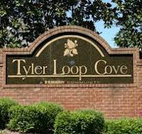
Tyler Loop Cove Homeowners’ Association, Inc.
Notes:
Good evening, neighbors, and welcome to our community meeting. On behalf of the HOA Board, thank you for taking the time to be here and for your continued commitment to making our neighborhood a welcoming, safe, and thriving place to live. Tonight, we will share important updates, discuss matters that affect our community, and provide an opportunity for constructive questions and feedback. I encourage everyone to participate respectfully and with the shared goal of strengthening our community. Thank you again for joining us—let’s get started.

Slide 2
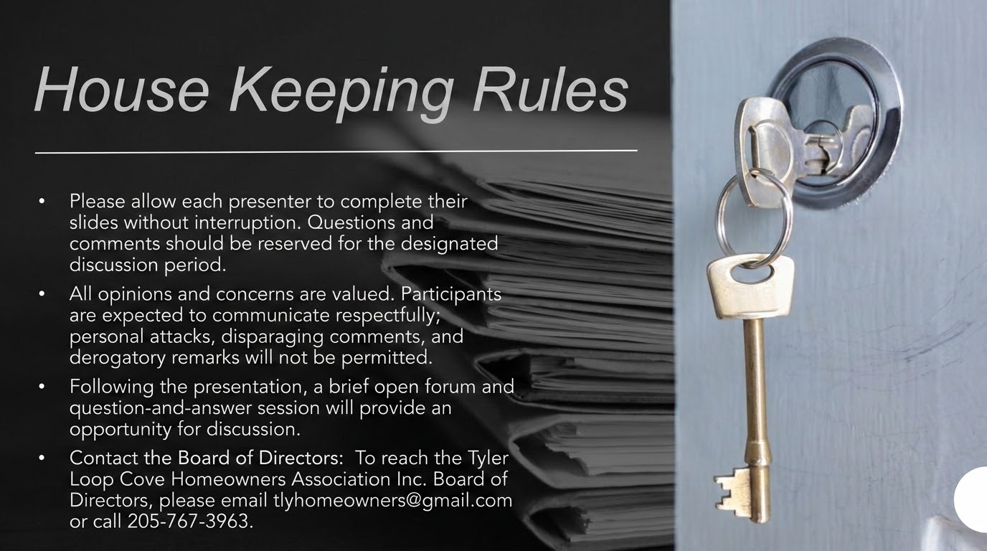
Notes:
To help tonight’s meeting run smoothly and ensure everyone has an opportunity to be heard, please allow each presenter and speaker to finish without interruption. Hold questions and comments until the designated discussion period and wait to be recognized by the chair before speaking. Please keep remarks brief, focused on the agenda item under discussion, and respectful of differing viewpoints; personal remarks, side conversations, and disruptive behavior will not be permitted. Silence mobile devices, step outside if you need to take a call, and avoid speaking over others. If a topic requires more time than the agenda allows, the Board may schedule a follow-up discussion or ask that the concern be submitted in writing. Our goal is to maintain a courteous, productive environment where all residents feel comfortable participating.

Slide 3

Agenda
Introduction
Meet The Board Members
Committee Updates
Financial Update
New and Old Business
Open Forum & Q&A

Slide 4

Meet Your Board Members
De’Naia Jackson- President
Rodney Feagins- Vice President
Pat Crenshaw- Secretary
Nichole Fenison- Vice Secretary
Treasure TBD
Architectural Review TBD
Notes:
I would now like to introduce the members of your HOA Board. Each Board position is entirely voluntary, and every member gives their time and effort because they care deeply about our neighborhood. We are homeowners just like you—we live here, share the same concerns, and are invested in the safety, appearance, financial stability, and overall well-being of our community. While we may not always agree on every issue, our shared purpose is to listen, make thoughtful decisions, and work together in the best interests of all residents. We appreciate your understanding, participation, and partnership as we continue working to make our community the best it can be.

Slide 5

Committee Updates
Clear Guidelines
Regular Updates
Conflict Mediation
Notes:
As your HOA board, we are committed to rebuilding trust. We are taking immediate action to get our association back on track by:
Clear Guidelines, Regular Updates, and Conflict Mediation: A strong HOA community depends on clear expectations, open communication, and a fair process for resolving concerns. The Board will work to ensure that community rules, responsibilities, and procedures are written in plain language, applied consistently, and made readily available to every homeowner. We will also provide regular updates about Board decisions, finances, maintenance projects, upcoming meetings, and other matters that affect the neighborhood, so residents remain informed and have meaningful opportunities to participate. When disagreements arise between neighbors or involving the Association, the Board will encourage respectful, solution-focused communication and, when appropriate, offer a neutral mediation process. Each concern will be heard fairly, handled privately when necessary, and reviewed in accordance with the governing documents, with the goal of finding practical resolutions that protect property values, preserve neighborly relationships, and support the well-being of the entire community. The Board is working hard to grow the community and wants to be a vital part of bringing the community together by: Assessing the Finances: Conducting a comprehensive audit of HOA accounts and dues. Restoring Maintenance: Prioritizing necessary repairs and regular upkeep of our community park. Reopening Communication: Establishing clear, reliable ways for you to contact us with questions or concerns and lastly, Commitment to Fairness and Transparency: We want to ensure that our community operates fairly, transparently, and in a way that benefits everyone. We deeply appreciate your patience and grace as we work to rectify past inactivity and improve our neighborhood

Slide 6

Financial Report and Updates
Notes:
Thank you to everyone who has paid the annual HOA dues. We understand that the request came on short notice. As the Board reconnects with the community and gets organized, these payments will help us move forward with neighborhood priorities.
So far, the HOA has received more than $18,000, and additional payments are still coming in. The power bill has been paid, including the cost of the community lights, and we should see a difference shortly.
The HOA is responsible for paying several shared community expenses. These include electricity for neighborhood lighting and the common area, Birmingham Water, upkeep of the common area, and Center Point Fire services related to the community fire hydrant.
As the current Board reviewed the HOA’s finances, we identified an oversight from the prior Board. Although we cannot go backward and change what has already occurred, we can learn from it and move forward responsibly. Our commitment is to keep the community informed about how HOA funds are collected, spent, and managed so homeowners will always know where their money is going.
Beginning next year, annual HOA fees will increase to $300. This adjustment is necessary to cover rising costs, restore and maintain community lighting, care for common areas, complete needed repairs, support reliable communication tools and administrative services, and build an appropriate reserve for future maintenance and unexpected expenses. Adequate funding will allow the Association to address problems promptly, improve safety, protect property values, and provide consistent services without relying on emergency assessments. The Board remains committed to using these funds responsibly and providing homeowners with regular, transparent financial updates.
This Board is starting fresh and plans to manage the HOA’s finances differently. Each month, homeowners will receive a simple financial update showing:
• how much money the HOA has;
• how much money came in and was spent compared with the budget; and
• how much unpaid HOA dues remain. Homeowners’ names will not be included in the unpaid dues report to protect their privacy.

Slide 7

New and Old Business
Notes:
Old Business: Our main goal is to restore the community lights as quickly and responsibly as possible so that our neighborhood is safer, more visible, and welcoming after dark. At the same time, every homeowner is asked to help keep their property free of debris, loose materials, and unnecessary trash. Trash carts should be placed at the curb only for scheduled collection and returned to their proper storage location, out of public view, promptly after pickup. We must also work together to keep all common areas free of litter, discarded items, and unwanted garbage. By addressing lighting and maintaining clean homes and shared spaces, we can improve safety, protect property values, and take pride in the appearance of our entire community.
New Business: Our new community website will launch on September 22, 2026, giving homeowners one convenient place to access the HOA bylaws and covenants, view upcoming events and friendly reminders, and make HOA payments. The website address is www.tylerloopcovehomeownersassociation.com. Homeowners can also contact the Board with questions, concerns, or important updates by emailing tlchomerowners@gmail.com or calling 205-767-3963. To further improve communication and keep everyone informed, the Board will distribute a community newsletter each quarter via email. Please make sure we have your email on file.

Slide 8

Upcoming Community Events
Maintenance and Cleanup Day
Movies Under the Stars in the Common Area
Notes:
Community Maintenance & Clean-Up Day: Let’s roll up our sleeves and make our neighborhood shine! Join us as we tidy our properties and shared spaces, spruce up the front entrance, groom lawns, and rake leaves. Every helping hand will make a visible difference and help create a cleaner, more welcoming community for everyone.
Movies Under the Stars: Get ready for a fun-filled evening with family, friends, and neighbors in the common area! One week before the event, we will email a list of three family-friendly movies so the community can vote for its favorite. Bring your chairs and blankets, settle in under the stars, and enjoy a memorable movie night together.
Refreshments will be served to make the evening even more enjoyable. We can’t wait to see you there

Slide 9

Open Forum

Slide 10
Q&A

